Slide 1
Working Around Conventions
VOLUME 1 – Influencing Key Configuration

Slide 2
Primary Key conventions
With-in your model implementations - there is a convention that the primary key property of a model be an integer named Id… and then that property will be created as an auto incrementing integer
If you want to use a name other than Id, then you can mark the non-conforming property name with the [Key] annotation
If you want the key to be user-provided, then meet the DatabaseGenerated attribute – this lets you enter the primary key for the entity rather than having the database generate it when the DatabaseGeneratedOption is set to None
  [DatabaseGenerated(DatabaseGeneratedOption.None)]
For the above, you need a using statement:
  using System.ComponentModel.DataAnnotations.Schema;

Slide 3

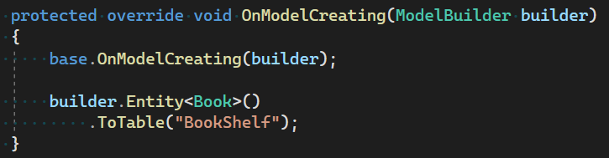
Context Class –table name CHANGES
The names of your Data Source Tables can be influenced in several ways, either thru Implicit convention or Explicit instruction:
  We can change the name of the DbSet<> collection that we are using which implicitly affects the generated Table Name::
  We can choose to specifically instruct EF Core to use a name we specify for just the Data Source Table name using the EF Core Fluent API (more on this within a future lesson):

